Slide 1
Data Mining Data per – processing
Ehsan Mirzaei
Jun 2022

Slide 2
Data per – processing
Data import / integration
Data cleaning
Missing data
Data transformation
Dimension Reduction
Python (Sklearn, Matplotlib)

Slide 3
What is pre-process data?
Refer to manipulation or dropping of data before it is used in order to ensure or enhance performance.

Slide 4
Why pre-process data?
Raw data contain incomplete, and noise.
Data may contain
Fields that are obsolete or redundant
Missing values
Outliers
Minimize garbage in, garbage out (GIGO)
Data preparation is 60% of effort for data mining process (Pyle)

Slide 5
Example
Income Field Contains $10,000,000
Income Field Contains -$40,000
Income Field Contains $99,999
Age Field Contains “C”
Age Field Contains 0
Marital Status Field Contains “S” – (Single or Separate)

Slide 6
Data import / integration
Data import / integration
Data cleaning
Missing data
Data transformation
Dimension Reduction
Python (Sklearn, Matplotlib)
Data can come from several sources
CSV file
Excel file
SQL DB
JSON file
…

Slide 7
Data import / integration
Data import / integration
Data cleaning
Missing data
Data transformation
Dimension Reduction
Python (Sklearn, Matplotlib)
Read From CSV
Mydata = pd.read_csv("C:\\Users\\...")
Read From Excel
Mydata = pd.read_excel(C:\\Users\\...")
Read From DB
import pyodbc
conn = pyodbc.connect('Driver={SQL Server};'
'Server=server_name;'
'Database=database_name;'
'Trusted_Connection=yes;')
cursor = conn.cursor()
cursor.execute('SELECT * FROM table_name')

Slide 8
Data Cleaning
Data import / integration
Data cleaning
Missing data
Data transformation
Dimension Reduction
Python (Sklearn, Matplotlib)
Remove duplicate data
Converting dates
Character manipulation
Handling missing values
Handling outliers
Data incoherence

Slide 9
Missing data
Data import / integration
Data cleaning
Missing data
Data transformation
Dimension Reduction
Python (Sklearn, Matplotlib)
Missing completely at random (MCAR)
There’s no relationship between whether a data point is missing and any values in the data set
Missing at random (MAR)
The missing data here is affected only by the complete (observed ) variables and not by the characteristics of the missing data itself
Missing not at random (MNAR)
The unobserved value of the variable with missing predicts missingness

Slide 10
Handling Missing Data
Data import / integration
Data cleaning
Missing data
Data transformation
Dimension Reduction
Python (Sklearn, Matplotlib)
Replace the missing value with some constant
Replace the missing value with the_
Mean
Mode
Replace the missing values with a value generated at random
Replace the missing values with imputed values

Slide 11

Data transformation
Data import / integration
Data cleaning
Missing data
Data transformation
Dimension Reduction
Python (Sklearn, Matplotlib)
Data transformation is a technique used to convert the raw data into a suitable format that eases data mining in retrieving the strategic information efficiently.
natural log transformation ln(𝑤𝑒𝑖𝑔ℎ𝑡)
the square root transformation √weight $\sqrt{weight}$
inverse square root transformation $\frac{1}{\sqrt{weight}}$
Normalization
Min-max
Z-score or standardization
Decimal scaling

Slide 12
Dimension Reduction
Data import / integration
Data cleaning
Missing data
Data transformation
Dimension Reduction
Python (Sklearn, Matplotlib)
Dimensionality reduction refers to techniques that reduce the number of input variables in a dataset.
some of the variables are correlated with each other.
highly correlated variables overemphasizes particular components
Use of too many predictor variables can

Slide 13
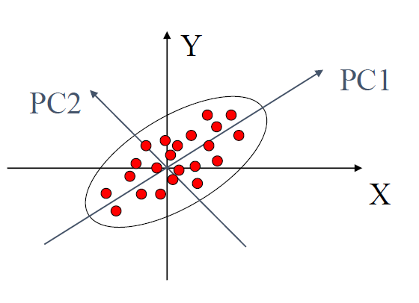
Dimension Reduction
Principle Components Analysis (PCA) as a dimension reduction technique.
Based on statistical procedure.
Convert a set of observations of possibly correlated variables into a set of values of linearly uncorrelated variables called principal components.

